Slide 1
Slots 05-06-07: Lesson 3 Basic Logics
Module-C-Logic Logic Constructs Programming Style Walkthroughs
Notes:
Prepared by Thân Văn Sử

Slide 2
Review
A variable is a name referencing to a memory location.
A data type defines: How the values are stored and how the operations on those values are performed.
4 primitive data types in C: int, char, float, double
Data stored are in binary format
Declare a variable in C: type var [=initialValue];
An identifier begin with a letter or ‘_’, the later symbols can be letters, digits and ‘_’
An user-defined identifier must not a C keyword.
Expression is a valid association of constants, variables, operators and functions.

Slide 3
Objectives
How to develop a C- program? → Logic constructs
When I develop a C-program, what are things that I should follow? → Programming styles
How I can understand a program? → Walkthroughs

Slide 4
Content
1- Logic constructs
2- Programming Styles
3- Walkthroughs
4- Bonus – Redirect a Program ( a technique is used in the ACM Contest)

Slide 5
1- Logic Constructs
Logic constructs: Expressions enable us to write programs that perform calculations and execute statements in a sequential order.
Structured Programming
Logic constructs:
Sequence constructs
Selection constructs (1/2, 1/n)
Iteration constructs
Notes:
Sequence : tuần tự ( + - x : )
Selection : chọn lựa ( rẽ nhánh )
Iteration : lặp

Slide 6
1.1- Structured Programming
Structure of a program code should be organize in a manner so that it is understandable, testable and readily modifiable.
➔It consists of simple logical constructs, each of which has one entry point and one exit point.
The beginning step for developing a program is DESIGN using
pseudo-coding or
flow charting
Mã giả
Lưu đồ

Slide 7
Structured Programming: Pseudo-code
Example: Calculating the absolute value of an integer inputted from the keyboard.
Prompt the user for an integer value
Accept an integer value from the user and store it in x
If x is negative then x = -x
Display x
Notes:
Mã giả : ( Pseudo-code ) : dùng lời để viết đoạn code

Slide 8
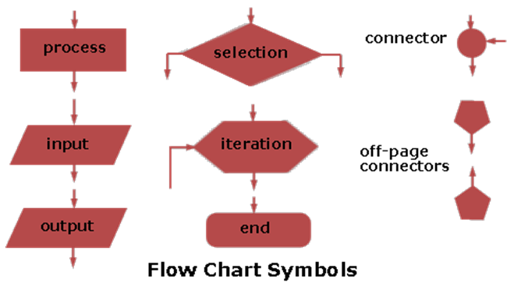
Structured Programming: Flowcharting
Describe the flow of a program unit symbolically
Quy tắc chung vẽ lưu đồ
Notes:
Lưu đồ : ( Flowcharting ) – Ít dung
\

Slide 9
1.2- Sequence Constructs
A sequence is either a simple statement or a code block.
Simple Statements
expression ;
Code Blocks
A code block is a set of statements enclosed in curly braces.
{
statement
...
statement
}
Notes:
Switch(hằng) – case: chỉ sài cho trường hợp cụ thể
If-else: sài cho trường hợp liên tục ( Ex: grade>9: ”A+”, grade>8:”A”…)

Slide 10
1.3- Selection Constructs
Select 1/2 | Select 1/n
if if … else If … else if …. else ? : (operator) | switch
Integral
expression
Condition ?
c1
c2
c3
default
TRUE
FALSE
Op1
Op2
Op3
Op4
Operation 1
Operation 2
Notes:
Khối lệnh rẽ nhánh -> vẽ trong hình thoi

Slide 11
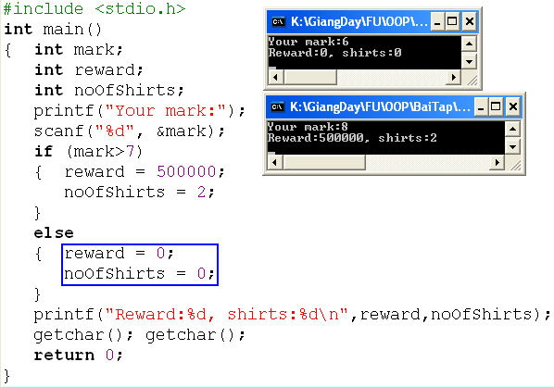
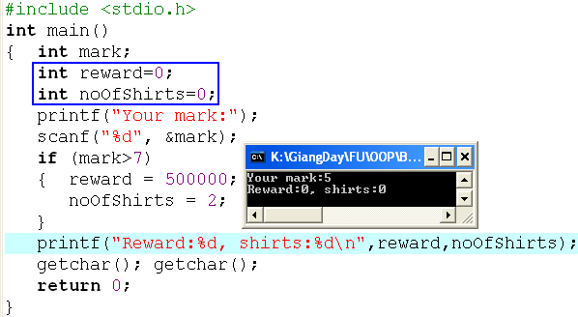
Selection Constructs: if … else
if (condition)
{ statements
}
if (condition)
{ statements
}
else
{ statements
}

Slide 12
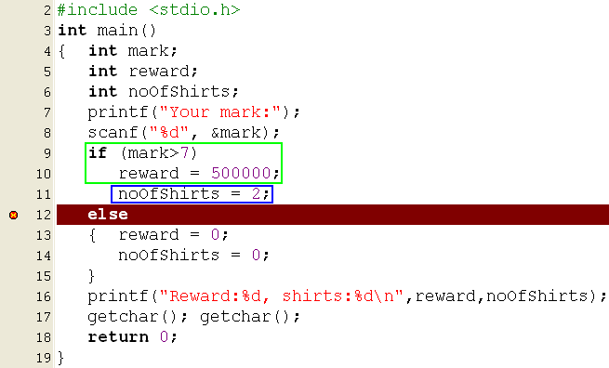

Selection Constructs: if … else
if (condition)
{ statements
}
else
{ statements
}
The compiler can not determine the if statement before the else statement.

Slide 13
Selection Constructs: if … else
Begin
N,t → int
Accept N
Compute t
Print out t
End
if (condition 1)
{ statements
}
else if (condition2)
{ statements
}
else
{ statements
}
Buying N T-shirts with promotion:
N<=3: 120000$/item
From 4th to 6th: 90000$/item
From 7th to 10th: 85000$/item
From 11th : 70000$/item
Describe the expression that will compute the paid value.
Nested if
Let N: number of T-shirts bought, t: money must be paid.
if (N <=3) t = N*120000 ;
else if (N<=6) t= 3*120000 + (N-3) * 90000;
else if (N<=10)
t= 3*120000 + 3*90000 + (N-6)*85000;
else
t= 3*120000 + 3*90000 + 4*85000 + (N-10)*70000;

Slide 14
Selection Constructs: if … else
if (condition 1)
{ statements
}
else if (condition2)
{ statements
}
else
{ statements
}
Similarly, describe the expression that will compute the paid value when we use electric power.
Implement it to a program.
Begin
N,t → int
Accept N
Compute t
Print out t
End
100
150
200
Number of kwhs
950
1250
1350
1550
prices

Slide 15
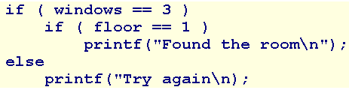
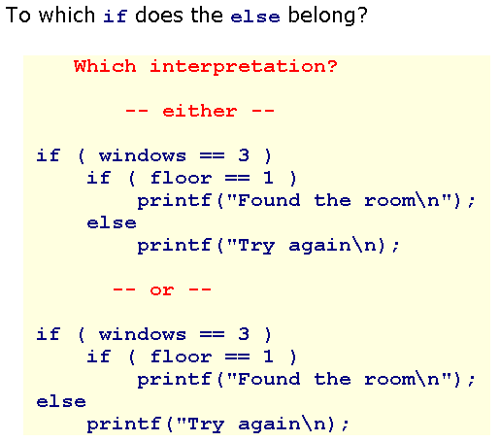
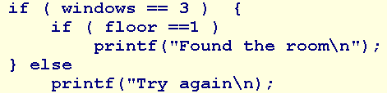
Selection Constructs: Dangling Else
Ambiguity may arise in the case of nested if else constructs.
?
The rule in C is that an else always belongs to the innermost if available. Use { } to explicitly determine statements
?

Slide 16
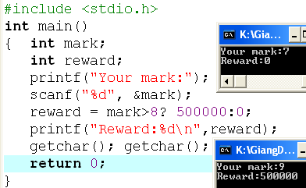
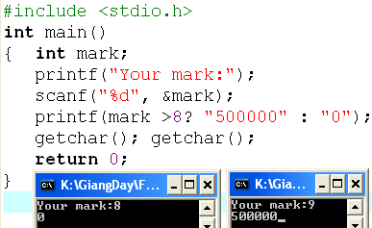
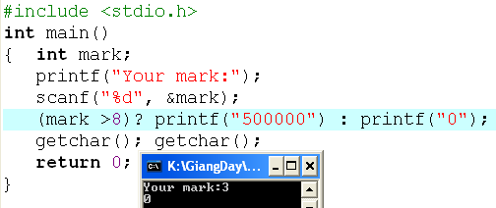
Selection Constructs: Operator ? :
(condition) ? True_Value : False_Value
Toán tử pano : Nếu ? Thực thi lệnh : còn lại

Slide 17
Selection Constructs: The switch statement
switch (variable or expression)
{
case constant :
statement(s);
break;
case constant :
statement (s);
break;
default:
statement (s);
}
Integral
expression
char / int
c1
c2
c3
default
Op1
Op2
Op3
Op4
If the break statement is missed, the next statements
are executed until a break is detected
or all statements in the body of the switch are executed.
Each case is an entry of a selection

Slide 18
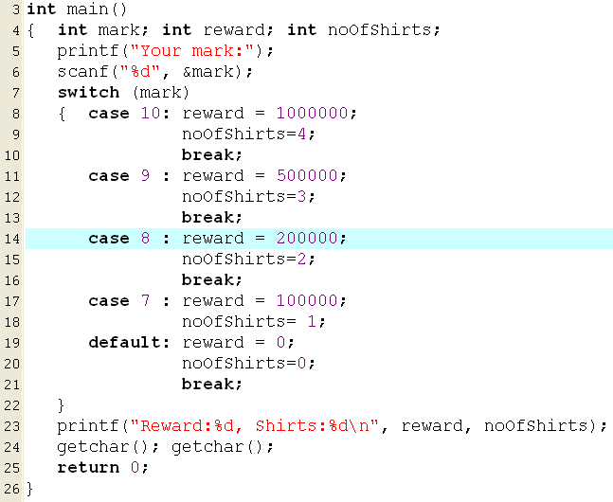
Selection Constructs: The switch statement
If input is 8, what are outputs?
200000 , 2
300000, 3
0, 0
1000000, 4
1500000, 10
None of the others
If input is 7, what are outputs?

Slide 19
Selection Constructs: switch…
Analysis
Nouns: expression num1 op num2
➔ double num1, num2; char op
result → double result
Verbs: Begin
Accept num1, op, num2 → “%lf%c%lf”
switch (op)
{ case ‘+’ : result = num1 + num2;
print out result;
break;
case ‘-’ : result = num1 - num2;
print out result;
break;
case ‘*’ : result = num1 * num2;
print out result;
break;
case ‘/’ : if ( num2==0)
print out “Divide by 0 “
else
{ result = num1 / num2;
print out result;
}
break;
default: print out “Op is not supported”
}
End
Write a program that allows user inputting a simple expression containing one of four operators +, -, *, / then the result is printed out to the monitor. Input format:
num1 operator num2,
Example: 4*5
Implement it.

Slide 20
1.4- Iteration (loop) Constructs
Loop/Iteration: some statements are executed repetitively
Structure of a loop:
Initial block.
Condition.
Task in each execution.
Types of iteration: fixed loops, variable loops
The iteration constructs are:
while
do while
for

Slide 21
Iteration…
Identify a loop:
Calculate S= 1+2+3+4+5+6+7+ … + 100
Some addition are performed ➔ Loop
Sum of some numbers they are inputted until user enters 0.
Accept and add numbers ➔ Loop

Slide 22
Iteration…
Identify a loop for an expression:
Left side → Initial block
Right side → Condition
An operation and preparations for the next iteration: Tasks in each iteration.
S=1+2+3+4+… + 100
→ S=0+1+2+3+4+… + 100
S=1*2*3*4*… * 100
→S=1*1*2*3*4*… * 100
S=0
(1) S=S+i;
(2) i=i+1;
i<=100
S=1
(1) S=S*i;
(2) i=i+1;
i<=100
i=1
i=1
S=1
i=2

Slide 23
Iteration…
S= 0 , n<=0
1 + 3 + 5 +… + n, n is odd
2 + 4 + 6 + … + n, n is even
S= 0 , n<=0
n + (n-2) + (n-4) + … + 0
Initial value:
S = 0;
i = n;
Condition i>0
Tasks: S += i;
i -=2;
Initial value:
S = 0
i = (n%2==1)? 1: 2;
Condition i <=n
Tasks: S += i;
i+=2;
S= 1 + 1/1⁰ + 1/ 2¹ + 1/3² + … + 1 /n^{n-1}
Initial value:
S = 1.0;
i = 1;
Condition i <=n
Tasks: S += 1.0/ pow ( i, i-1 );
i = i +1;
math.h

Slide 24
Iteration: for statement
for ( InitBlock; Condition; Task2) Task1;
for ( Init1, Init2; Condition ; Task1, Task2);
InitBlock;
for ( ; Condition ; Task2) Task1;
InitBlock;
for ( ; Condition ;)
{ Task1;
Task2;
}
InitBlock
no
Condition?
yes
Task1
Task2
The condition will be tested before tasks are performed.

Slide 25
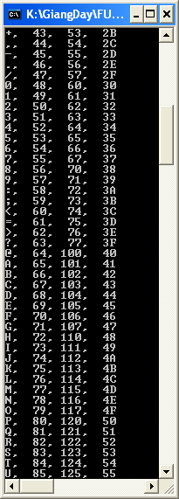
Iteration…
Write a program that will print out the ASCII table.
ASCII code : 0 → 255
Initialize: int code =0
Condition: code <256
Task:
Print the code using 4 format: %c, %d, %o, %X
code = code +1

Slide 26
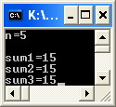
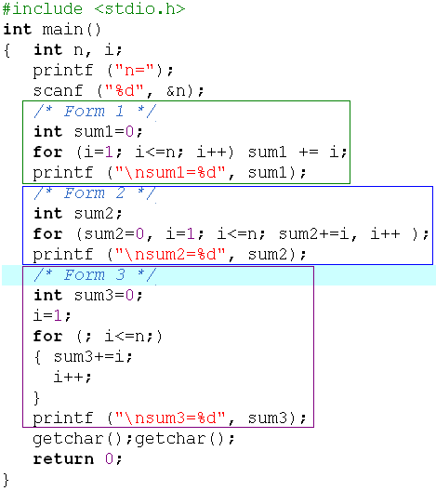
Iteration…
Write a program that will calculate 1+2+3+…+n.
Accepted variable: int n
Sum 1 .. N → int sum
Algorithm
Accept n
Loop:
Initialize i=1, sum=0
Condition i<=n
Tasks: sum += i; i++;
Print out sum

Slide 27
Iteration: while/do…while statements
InitBlock
InitBlock
no
Condition?
Task1
yes
Task2
Task1
yes
no
Task2
Condition?
/* Initializations */
while (condition)
{ statements;
}
/* Initializations */
do
{ statements;
}
while (condition) ;
The condition will be tested before tasks are performed.
The condition will be tested after tasks are performed.

Slide 28
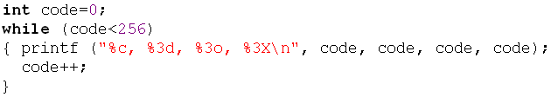
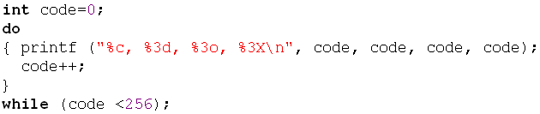
Iteration: while/do…while statements
Write a program that will print out the ASCII table.
ASCII code : 0 → 255
Initialize: code =0
Condition: code <256
Task:
Print the code using 4 formats: %c, %d, %o, %X
code = code +1

Slide 29
Iteration…
Write a program that will print out the sum of integers inputted by user. The input will terminate if user enters the value 0.
Nouns: inputted integer → int x,
sum of integers → int sum
Tasks (algorithm)
Begin
sum =0
do
{ accept x;
sum += x;
}
while (x!=0);
Print out sum
End
Implement it by yourself.

Slide 30
Iteration…
Write a program that permits user entering some characters until the ENTER key (code 10) is pressed. The program will print out the number of digits, number of letters, number of other keys were pressed. Accept a character: c=getchar();
Nouns:
character inputted → char c, Number of digits → int noDigits
Number of letters → noLetters, Number of other keys → noOthers
#define ENTER 10
Algorithm
Begin
noDigits = noLetters = noOthers = c= 0
printf(“Enter a string:”);
While (c!=ENTER)
{ accept c;
if ( c>=‘0’ && c <=‘9’) noDigits++;
else if ( (c>=‘a’ && c <=‘z’) || (c>=‘A’ && c <=‘Z’) ) noLetters++;
else noOthers++;
}
Print out noDigits, noLetters, noOthers
End
The while statement is intentionally used. So, c=0 is assigned and the condition c!=ENTER is evaluated to TRUE
Implement it by yourself.
Input form:
abc1234fGH+-*/?(ENTER)

Slide 31
Iteration…
When a loop is needed, what loop statement should be used?
➔ All of them can be used to satisfy your requirement.

Slide 32
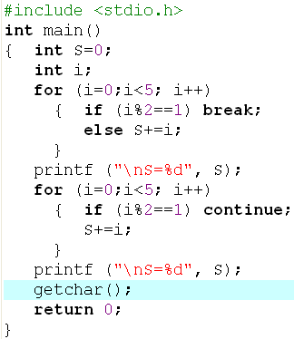
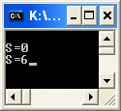
Iteration: Break/ Bypass a loop
0 1 2 3 4 5
0 1 2 3 4 5

Slide 33
Iteration Constructs: Flags
The one entry, one exit principle is fundamental to structured programming.
C includes three keywords that allow jumps across statements: goto, continue, and break. Using any of these keywords, except for break in a switch construct, violates the one entry, one exit principle of structured programming.

Slide 34
Iteration Constructs: Flags…
To improve readability, programmers advocated:
the use of whitespace to identify the logical structure of the code
the abolition of all goto statements
the abolition of all continue statements
the abolition of all break statements, except with switch
A technique for avoiding jumps is called flagging. A flag is a variable that keeps track of a true or false state.

Slide 35
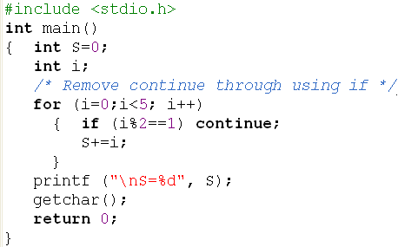
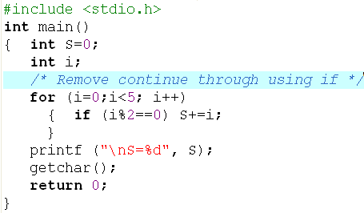

Iteration Constructs: Flags…
Use if instead of continue

Slide 36
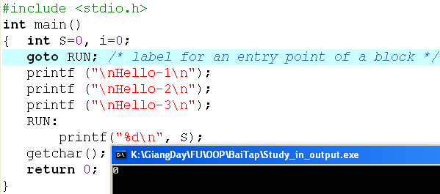
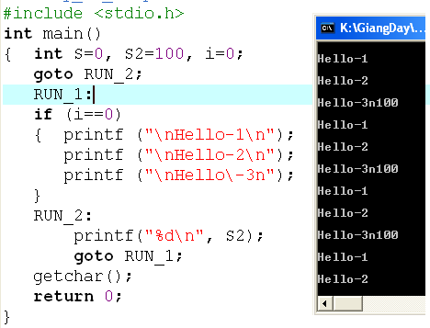
Iteration Constructs: Flags…
Loop infinitively

Slide 37
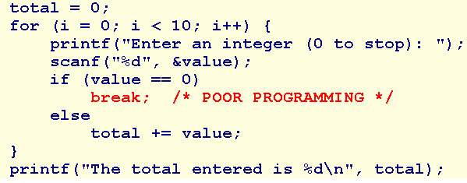
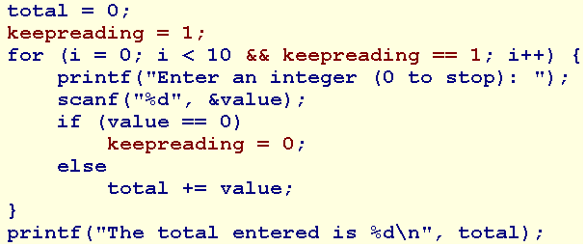
Iteration Constructs: Flags…
No flag is used.
A flag is used.

Slide 38
2- Programming Styles
Habits in programming
A well-written program is a pleasure to read. Other programmers can understand it without significant effort. The coding style is consistent and clear throughout.
Develop your own style guide or adopt the style outlined here or elsewhere, but adopt some style.
Recommendations on
Naming
Indentation
Comments
Magic Values
General Guidelines

Slide 39
Programming Styles: Naming
Adopt names that are self-descriptive so that comments clarifying their meaning are unnecessary
Use names that describe identifiers completely, avoiding cryptic names
Prefer nouns for variable names
Keep variable names short - studentName rather than theNameOfAStudent
Keep the names of indices very short - treat them as mathematical notation

Slide 40
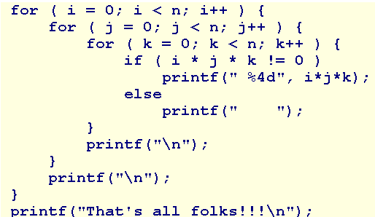
Programming Styles: Indentation
Indent the body of any construct that is embedded within another construct. For example,
Use in-line opening braces or start opening braces on a newline but don't mix the two styles.

Slide 41
Programming Styles: Comment
Use comments to declare what is done, rather than describe how it is done.
Comments introduce what follows.
Keep them brief and avoid decoration.

Slide 42
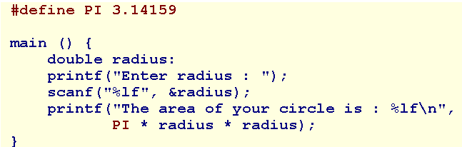
Programming Styles: Magic Values
These may be mathematical constants, tax rates, default values or names.
To improve readability, assign symbolic names to these magic values and refer to the symbolic names throughout the code.
Use the directive
#define SYMBOLIC_NAME value

Slide 43
Programming Styles: Magic Values…
Compiler Idiosyncracies
Use #define to manage idiosyncracies (đặc điểm) across platforms.
For example, the Borland 5.5 compiler does not recognize the long long data type. Instead, it recognizes an _int64 data type. To improve portability, #define the data type using a symbolic name such as LONG_LONG and embed that name throughout our code.

Slide 44
Programming Styles: Guidelines
Limit line length to 80 characters - both comments and code
Avoid global variables
Select data types for variables wisely and carefully
Initialize a variable when declaring it only if the initial value is part of the semantic of the variable.
If the initial value is part of an algorithm, use a separate assignment statement.
Avoid goto, continue, break except in switch.
Avoid using the character encodings for a particular machine.
Use a single space or no spaces either side of an operator.

Slide 45
Programming Styles: Guidelines
Use in-line opening braces or start opening braces on a newline but don't mix the two styles.
Initialize iteration variables in the context of the iteration
Avoid assignments nested inside logical expressions
Avoid iterations with empty bodies - reserve the body for the algorithm
Limit the initialization and iteration clauses of a for statement to the iteration variables
Distribute and nest complexity

Slide 46
Programming Styles: Guidelines
Avoid fancy algorithms that may be efficient but are difficult to read
Add additional comments where code has been fine tuned for efficient execution
Add an extra pair of parentheses where an assignment is also used as a condition
Remove unreferenced variables
Remove all commented code and debugging statements from release and production code

Slide 47
3- Walkthroughs
Understand code is a skill of programmer.
To understand code, we should know how the code execute.
To know how the code execute, we should perform each instruction.
A walkthrough is
a record of the changes that occur in the values of program variables as a program executes and
a listing of the output, if any, produced by the program.
Ways to perform a walkthrough
Memory Map → You knew that
Walkthrough Tables → A simpler way

Slide 48
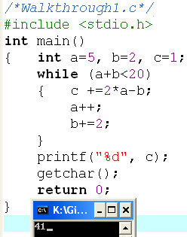
Walkthroughs: Demo.
a | b | a+b | c
5 | 2 | 7 | 1
6 | 4 | 10 | 9
7 | 6 | 13 | 17
8 | 8 | 18 | 25
9 | 10 | 19 | 33
10 | 12 | 22 | 41
Output
41

Slide 49
Walkthroughs: Demo.
int n, i, S=0;
scanf(“%d”, &n);
for (i=1; i<=n; i+=3)
if (i%2!=0 && i%3!=0) S+=i;
printf(“%d”, S);
What is the output if the input is 15?
n | 15
i | 1 | 4 | 7 | 10 | 13 | 16
S | 0+1 → 1 |  | 1+7 → 8 |  | 8+13→21
S=21

Slide 50
Walkthroughs: Demo.
int m,n, i, S=0;
scanf(“%d%d”, &n, &m);
for (i=m; i<=n; i++) S+=i;
printf(“%d”, S); S=0
What is the output if the input are 8 12?
Modify | Input
“%d %d” | 12 8
“%d%d” | 12 8
“%d%d” | 12 8
“%d-%d” | 12-8
Test the program:
int m,n, i, S=0;
scanf(“%da%d”, &n, &m);
for (i=m; i<=n; i++) S+=i;
printf(“%d”, S);
What is the output if the input are 8a12?

Slide 51
Walkthroughs: Demo.
Study the following code:
int n=15;
int S=0;
i=1;
while (i<2*n)
{ S+= i;
i*=4;
}
Give your opinion.
S=21
S= 85
A syntax error

Slide 52
Extra Demo: Print star characters
i= 1
2
3
4
5
6
N=6
*
**
***
****
*****
******
Print out 1*, “\n”
Print out 2*, “\n”
Print out 3*, “\n”
Print out 4*, “\n”
Print out 5*, “\n”
Print out 6*, “\n”
i
Accept N;
for ( i=1; i<=N; i++)
{ for (j=1; j<=i; j++) printf(“*”);
printf (“\n”);
}

Slide 53
Extra Demo: Multiplication Table
N=5
5x 1= 5
5x 2=10
5x 3=15
5x 4=20
5x 5=25
5x 6=30
5x 7=37
5x 8=40
5x 9=45
5x10=50
Accept n;
for ( i=1; i<=10; i++)
Print out “%dx%2d=%2d\n”, n, i, n*i

Slide 54
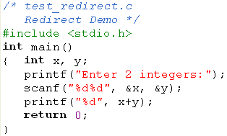





4- Redirect a Program
A characteristic is supported by the operating system and it is used in the ACM International contest.
➔ So, pay attention to input/output formats.

Slide 55
Summary
Logic constructs = Statements can be used in a program.
3 Basic constructs: Sequence, selection constructs (if, if…else, ?:, switch), Iteration constructs (for/ while/ do … while)
Walkthrough: Code are executed by yourself, Tasks in a walkthrough: a record of the changes that occur in the values of program variables and listing of the output, if any, produced by the program.

Slide 56
Thank You

